Slide 1
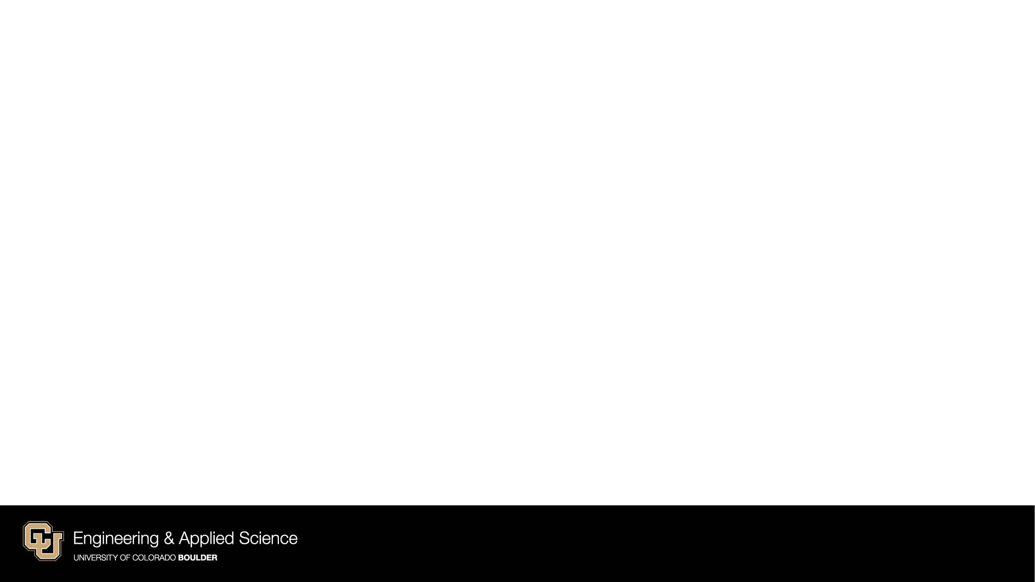
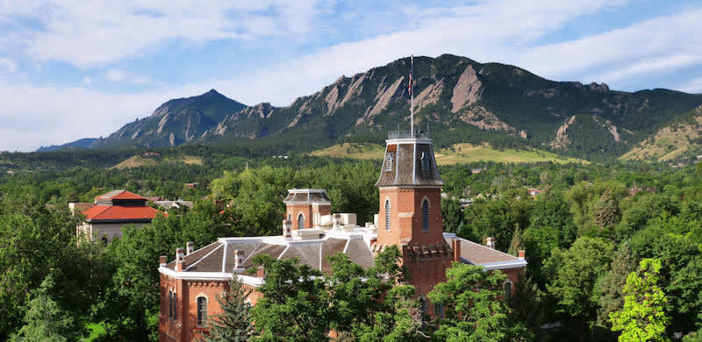
Cybersecurity Expert Interview Flipgrid Reflection
University of Colorado Boulder
DATA SCIENCE

Slide 2
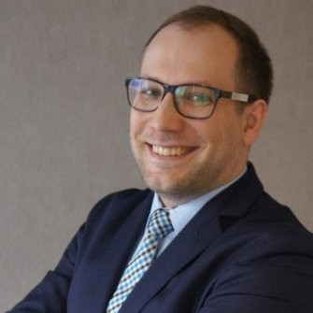

Michał Kałuziński
Currently
HSBC: Senior Risk Steward - Technology and Cyber Security Risk
Previously
UBS: IT Risk Manager, Associate Director
Masters in Law from Jagiellonian University in Krakow in 2013
DATA SCIENCE
Notes:
Today, I'll be reporting on my recent interview with Michał Kałuziński, a Senior Risk Steward in Technology and Cyber Security at HSBC. Michał provided valuable insights into the cybersecurity landscape, and I'm excited to share his perspectives with you. We had a great conversation and veered off the 5 questions I set out to discuss, but I’ll try to stay within the 5 question outline. Also, michal is in Poland so his experience as a European will be slightly different than us who are in the US.
Like I said, currently he is at HSBC as a Senior risk steward: he oversees risk management strategies within an their technology and cybersecurity departments. He identifies potential risks, assesses their impact, and creates strategies to mitigate or address them effectively. He collaborate with various teams to ensure compliance with security protocols and regulatory requirements, as well as to implement measures to protect against cyber threats. Additionally, he provides guidance on security best practices and contributes to the development of security policies and procedures.
Previously he was at UBS as an IT risk manager. He graduated with a masters in law in 2013

Slide 3
Question 1
What are the biggest cybersecurity risks you face on a day-to-day basis, or what keeps you up at night?
Ever-evolving threat landscape
Ransomware attacks
Phishing attacks
Advanced persistent threats
Ensuring security of critical systems and information
Potential impact on confidentiality, integrity, and availability of data
DATA SCIENCE
Notes:
I first asked him about the biggest risks he faces on a day to day basis. According to Michał, one of the most significant cybersecurity risks he encounters daily is the evolving threat landscape. Threats such as ransomware, phishing attacks, and advanced persistent threats constantly challenge their defenses. He emphasized the importance of ensuring the security of critical systems and information, as the potential impact of these risks could be severe.

Slide 4
Question 2
How do you use data science to help you solve your issues?
Utilize advanced analytics and machine learning algorithms
Analyze vast amounts of data in real-time
Detect anomalies and potential security breaches more effectively
Enhance threat detection capabilities
Proactively respond to emerging threats
DATA SCIENCE
Notes:
Next I asked how he used data science. Michał highlighted the crucial role of data science in their cybersecurity efforts. They leverage advanced analytics and machine learning algorithms to analyze vast amounts of data in real-time. This enables them to detect anomalies and potential security breaches more effectively, enhancing their threat detection capabilities and allowing for proactive responses to emerging threats.

Slide 5
Question 3
What are the fundamental skills you need to know to do your job appropriately?
Technical expertise in cybersecurity principles and best practices
Knowledge of network security, encryption protocols, and vulnerability assessment techniques
Understanding of regulatory requirements such as GDPR and ISO 27001
Strong analytical capabilities
Communication and collaboration skills for engaging with stakeholders
DATA SCIENCE
Notes:
I then asked about the fundamental skills he needs. According to Michał, the role of a Senior Risk Steward requires a diverse skill set. Technical expertise in cybersecurity principles and best practices is essential, along with a deep understanding of regulatory requirements such as GDPR and ISO 27001. Strong analytical capabilities, coupled with communication and collaboration skills, are also critical for engaging with stakeholders and implementing robust risk mitigation strategies.

Slide 6
Question 4
How has the landscape changed since you graduated in 2013?
Technological advancements expanding the attack surface
Rise of cloud computing, mobile technologies, and IoT
Cyber threats becoming more sophisticated and pervasive
Evolution of regulatory landscape with stricter data protection regulations
Need for organizations to adapt cybersecurity strategies accordingly
DATA SCIENCE
Notes:
Michal has been in the industry since 2013, so I wanted to see how the industry has changed. Since graduating in 2013, Michał noted significant transformations in the cybersecurity landscape. Technological advancements have expanded the attack surface, with the rise of cloud computing, mobile technologies, and the Internet of Things (IoT). Cyber threats have become more sophisticated and pervasive, driving the need for organizations to adapt their cybersecurity strategies accordingly.

Slide 7
Question 5
Where do you see the industry in 10 years?
Further evolution and innovation in the cybersecurity industry
Increased convergence between cybersecurity and emerging technologies
Opportunities and challenges presented by AI, quantum computing, and blockchain
Emphasis on holistic and collaborative approach to cybersecurity
Importance of information sharing and collective defense mechanisms
DATA SCIENCE
Notes:
Lastly I asked where he saw the industry going. Looking ahead, Michał envisions further evolution and innovation in the cybersecurity industry. He anticipates increased convergence between cybersecurity and emerging technologies such as artificial intelligence, quantum computing, and blockchain. Additionally, he emphasized the importance of a holistic and collaborative approach to cybersecurity, with an emphasis on information sharing and collective defense mechanisms.

Slide 8
Thank You!
Bullet 1
Bullet 2
Bullet 3
DATA SCIENCE

